Slide 1
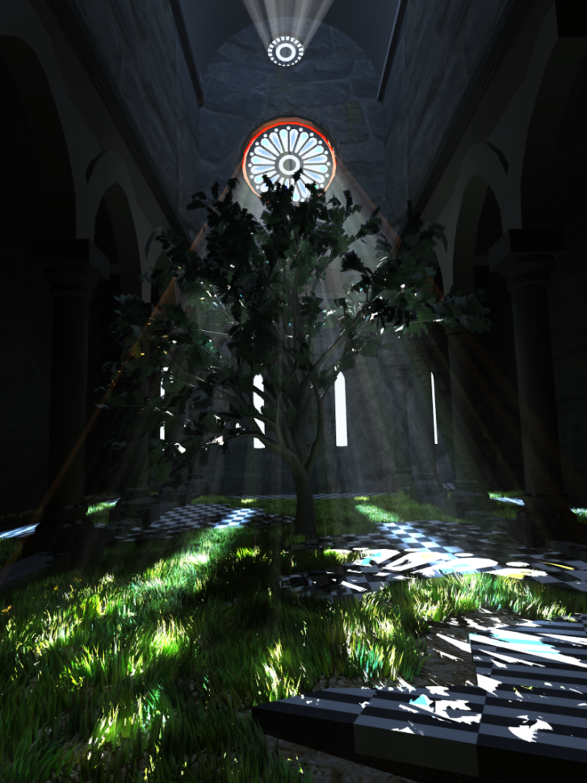
Efficient Real-Time Shadows
Elmar Eisemann (TU Delft)
Ulf Assarsson (Chalmers University)
Nickolay Kasyan (Crytek)
Michael Schwarz
Michael Wimmer (TU Wien)

Slide 2
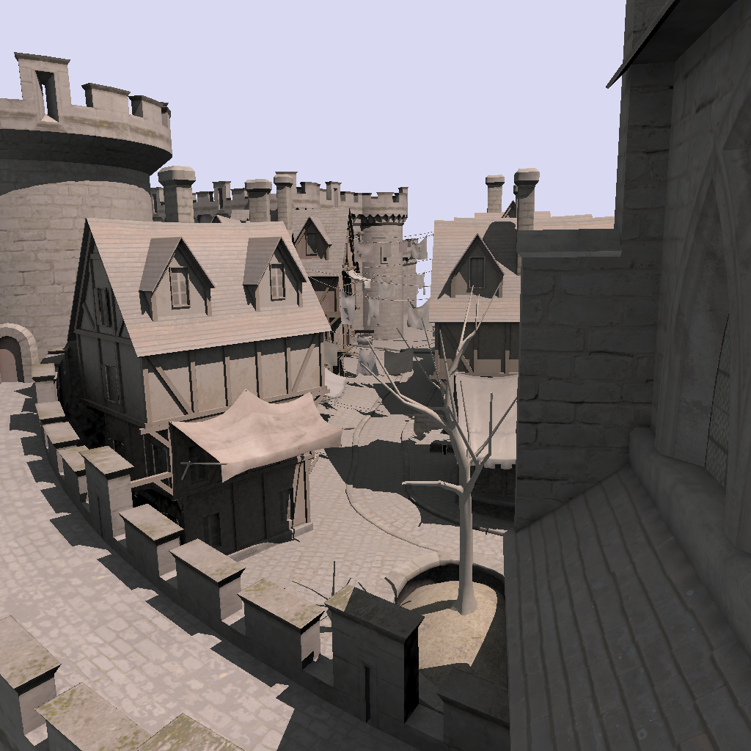
Basic Shadow Techniques: - Shadow Maps and Shadow Volumes (15 min)
Ulf Assarsson
Chalmers University of Technology

Slide 3
Ways of Thinking about Shadows
As volumes of space that are dark
Shadow Volumes [Franklin Crow 77]
As places not seen by a light source looking at the scene
Shadow Maps [Lance Williams 78]
Notes:
There are different ways to think about shadows.
We can think of them as volumes of space that are dark, and that directly corresponds to the Shadow Volume algorithm.
Or, we can think of shadows as places not seen by a light source looking at the scene, and that directly correspond to Shadow Maps.
.

Slide 4
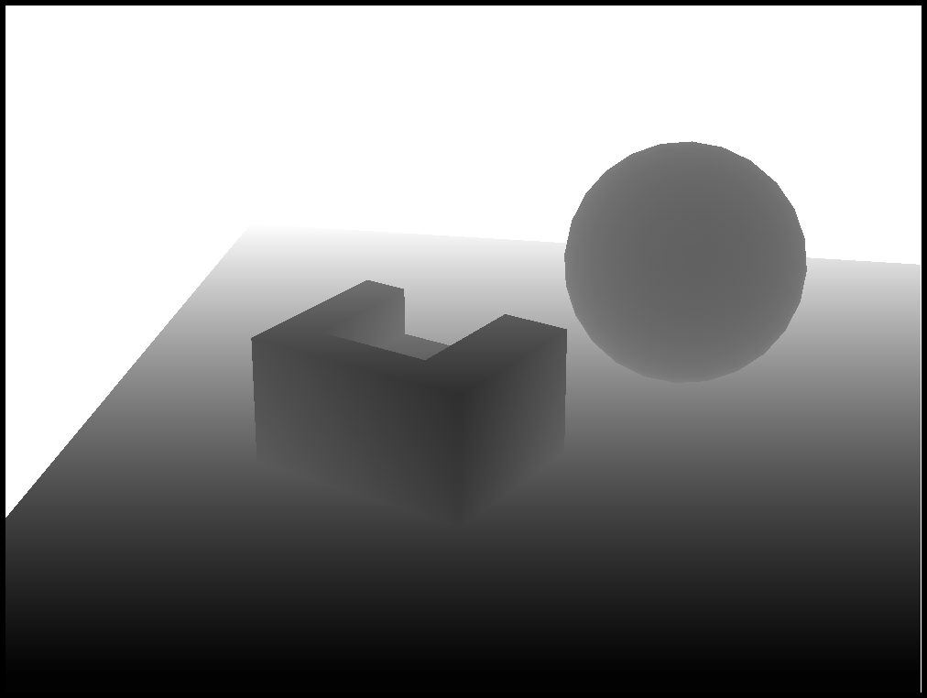
Shadow Maps
Basic Algorithm – the simple explanation:
Idea:
Render image from light source
Represents geometry in light
Render from camera
Test if rendered point is
visible in the light’s view
If so -> point in light
Else -> point in shadow
Shadow Map (light’s view)
Notes:
Here is the basic algorithm and the most simple explanation of it.
We start by rendering an image from the light source, and everything that is represented in this image is in light.
Then, we render the scene from the camera, and for each rasterized fragment, we test if the rendered point is visible in the light’s view.
If it is, then the point is in light.
Otherwise, the point is in shadow.
Let’s see an example…

Slide 5
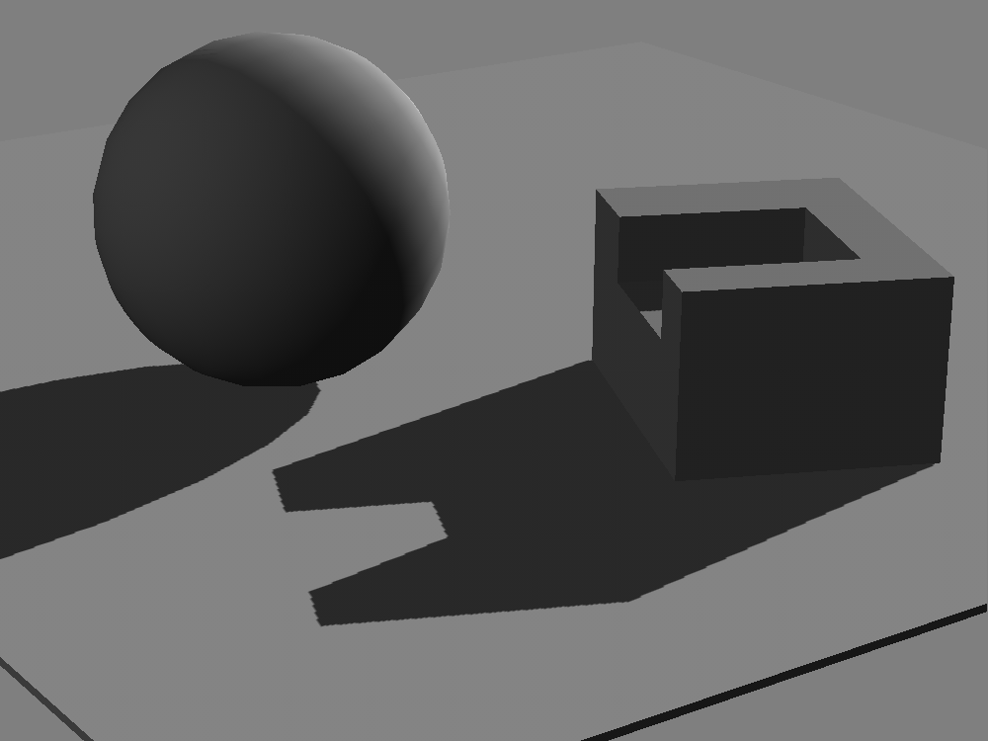
Shadow Maps
Point not represented in shadow map (point is behind box)
Camera’s view
Light’s view
(Shadow Map)
Notes:
Here is the camera’s view and here is the light’s view.
For every fragment that is rasterized in the camera’s view, we test if its 3D-position is represented in the light’s view by transforming the 3D-position from cam-space to light space.
Here, we see that this green fragment is represented in the light’s view, so it is lit.
Here is a fragment in shadow, and we see that this point is not represented in the shadow map. It is behind the box.
So, this red point is in shadow.
So, how do we test if a point is visible in the light’s view?

Slide 6
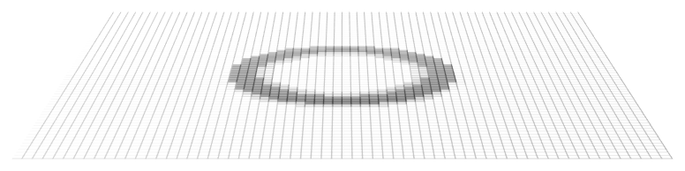
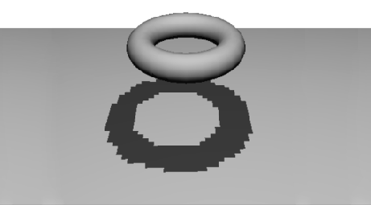
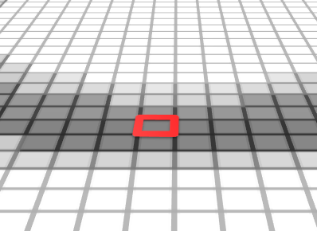
Depth Comparison
Render depth image from light
A fragment is in shadow if its depth is greater than the corresponding depth value in the shadow map
Shadow Map
Camera’s view
Notes:
We actually render a depth image from the light source. Each pixel stores the depth to the corresponding surface.
For every fragment in the camera’s view, we test if its depth is higher than the value stored in the shadow map.
Here is a fragment in the camera’s view.
Here is the fragment’s depth from the light source
Here is the value in the shadow map, and its corresponding depth.
And as we can see, the fragment’s depth is higher than the value in the shadow map, so the point is in shadow.

Slide 7
Shadow Maps
Pros
Very efficient: “This is as fast as it gets”
Cons…
Notes:
Now, this is essentially the fastest shadow algorithm for dynamic objects that we can ever dream of creating. Rendering depth maps is heavily optimized on todays hardware.
But there are drawbacks…

Slide 8
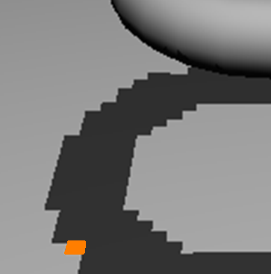
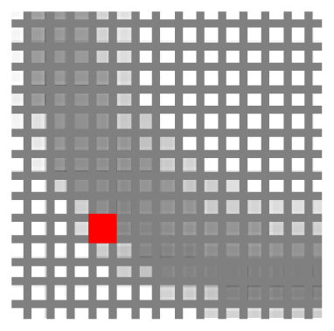
Shadow Maps - Problems
Low Shadow Map resolution results in jagged shadows
from viewpoint
from light
Notes:
Here is a scene rendered from the camera and from the light.
Here is the discretized shadow map.
This orange region is represented by the same shadow map pixel.
So low resolution shadow maps result in jagged shadows.
OK – so let’s then just increase the resolution. While that improves the quality, it can never completely remove the problem, because the camera can zoom in infinitely.
And even with infinite resolutions there is another problem…

Slide 9
Shadow Maps - Problems
In addition:
A tolerance threshold (bias) needs to be tuned for each scene for the depth comparison
Notes:
We also need a tolerance threshold, or so called bias value, that needs to be fine tuned for each scene to make the depth comparison work as expected.

Slide 10
Bias
Need a tolerance threshold (depth bias) when comparing depths to avoid surface self shadowing
Shadow map
Shadow map sample
bias
View sample
Surface
Notes:
Here is a shadow map and a surface.
Here is the frustum for a pixel, and…
… this is the point sampled in the shadow map, which represents the surface at a fixed depth, and…
… this is a point sampled from the camera.
As you can see, our view sample actually has a higher depth from the light, than the shadow map sample.
So, just a simple depth comparison would incorrectly regard the view sample as being shadowed.
We need a tolerance threshold (or depth bias) when comparing depths for considering the two points as belonging to the same surface.

Slide 11
Bias
Need a tolerance threshold (depth bias) when comparing depths to avoid surface self shadowing
Shadow map
Shadow map sample
bias
View sample
Surface
Notes:
If the bias is too small, then we will get incorrect self shadowing, which is often called z-fighting.
… and…

Slide 12
Bias
Need a tolerance threshold (depth bias) when comparing depths to avoid surface self shadowing
Shadow map
Shadow map sample
bias
View sample
Surface
Surface that should be in shadow
Notes:
… if the bias is too large, then a surface that should be in shadow will incorrectly be regarded as lit (as you can see on this gray object below the shadowing surface).
This typically manifests itself as light leaking at contact shadows.
There are several suggestions on how to attack this problem…

Slide 13
Ameliorating the Bias
Midpoint Shadow Maps [Woo 92]
Shadow map
Shadow map sample
View sample
Further methods:
Second Depth Shadow Mapping [Wang and Molnar94]
Dual Depth Layer [Weiskopf and Ertl 04]
midpoint
Notes:
For instance, the midpoint shadow maps.
This adds a more natural bias…
The idea is to store fake shadow casting geometry in the shadow map. Geometry that is not represented in the lights view. This can be done by storing the mid-values between the first and second depth layer from the light. But problems will still appear near silhouettes.

Slide 14
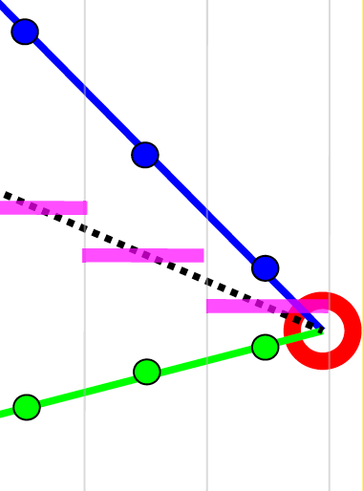
Ameliorating the Bias
Midpoint Shadow Maps [Woo 92]
Shadow map
Shadow map sample
View sample
Further methods:
Second Depth Shadow Mapping [Wang and Molnar94]
Dual Depth Layer [Weiskopf and Ertl 04]
midpoint
Notes:
The pink lines represent the midpoint depths stored in the shadow map. In other words, the mid points between the first visible layer in the shadow map and the second depth layer.
As you can see, near the silhouette edge (in this red circle), there can still be view samples that have a higher depth than the midpoint samples.
There are other suggestions, such as Second Depth Shadow Mapping, Dual depth layers or using triangle id’s but none of them completely remove the problem.

Slide 15
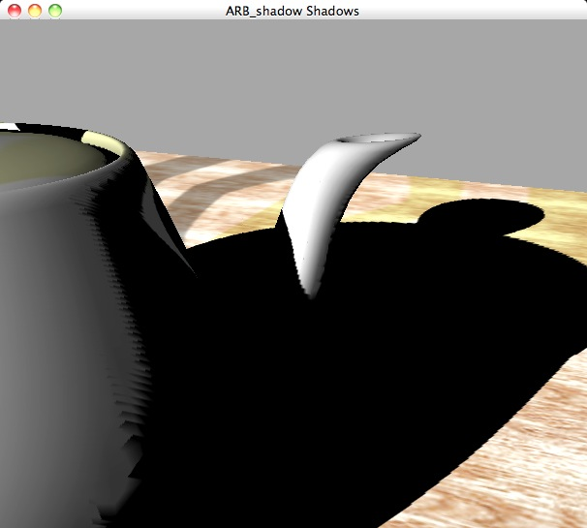
Shadow Maps
Notes:
And here is an image highlighting the shadow-map resolution problems and also biasing problems.
Michael Wimmer will describe how to improve the quality of this, in his session after my session.
But there is also a different way to address these issues, which might seem more natural.
The artifacts we deal with come from the fact that we discretized the geometry into an image from the light. And then, we compare these values to a discretization from the camera position. And the sampled points from the two discretizations will in practice never be the same.
So, lets see how we can totally avoid this…

Slide 16
Shadow Volumes
Notes:
And that leads us into shadow volumes.

Slide 17
Shadow Volumes
Concept
Create volumes of “space in shadow” from each triangle
Each triangle creates 3 quads that extends to infinity
Notes:
The concept of shadow volumes is to create volumes of “space in shadow”, from every triangle.
Each triangle in the scene creates 3 quads which extends to infinity.
If an object is inside the volume, it is in shadow. Otherwise, it is in light.

Slide 18
Shadow Volumes
To test a point, count how many shadow volumes it is located within. One or more means point is in shadow
Notes:
To test if a point is in shadow, we count how many shadow volumes it is located within. If it is within 1 or more, then the point is in shadow.
How do we check if the point is inside a shadow volume?

Slide 19
Shadow Volumes
To test a point, count how many shadow volumes it is located within. One or more means point is in shadow
Notes:
Assume that the eye is located in light. Then, we can follow a ray from the eye to the point. If we go into more shadow volumes than we go out of shadow volumes, then the point is in shadow.
,

Slide 20
Shadow Volumes
To test a point, count how many shadow volumes it is located within. One or more means point is in shadow
0
+2
Notes:
Let’s see another example.
This point is inside two shadow volumes,… and…
…this point is inside zero shadow volumes.
What we really would like to have is a counter per pixel

Slide 21
Shadow Volumes - concept
A counter per pixel
If we go through more frontfacing than backfacing polygons, then the point is in shadow
+
+
-
-
0
+2
Notes:
We also note that we can do the counting as follows: if we go through more frontfacing than backfacing shadow volume quads, then the point is in shadow.
We count +1 when we go through a front-facing shadow quad, and -1 when we go through a back-facing shadow quad.
The nice observation is that we don’t need to do this counting with ray tracing. We can use standard rasterization.

Slide 22
Shadow Volumes - concept
Perform counting with the stencil buffer
Render front facing shadow quads to the stencil buffer
Inc stencil value, since those represents entering shadow volume
Render back facing shadow quads to the stencil buffer
Dec stencil value, since those represents exiting shadow volume
0
0
Notes:
The stencil buffer gives us a counter per pixel.
We render the front-facing shadow-volume polygons to the stencil buffer and increment the stencil values, since that represents going into a shadow volume.
And then, we render the back-facing shadow-volume polygons (click), decrementing the stencil values, since that represents going out of shadow volumes.
We also disable the updating of the z-buffer, but we keep the depth test as usual.

Slide 23
Shadow Volumes - concept
Perform counting with the stencil buffer
Render front facing shadow quads to the stencil buffer
Inc stencil value, since those represents entering shadow volume
Render back facing shadow quads to the stencil buffer
Dec stencil value, since those represents exiting shadow volume
No updating of z-buffer
+
+1
+1
Notes:
The stencil buffer gives us a counter per pixel.
We render the front-facing shadow-volume polygons to the stencil buffer and increment the stencil values, since that represents going into a shadow volume.
And then, we render the back-facing shadow-volume polygons (click), decrementing the stencil values, since that represents going out of shadow volumes.
We also disable the updating of the z-buffer, but we keep the depth test as usual.

Slide 24
Shadow Volumes - concept
Perform counting with the stencil buffer
Render front facing shadow quads to the stencil buffer
Inc stencil value, since those represents entering shadow volume
Render back facing shadow quads to the stencil buffer
Dec stencil value, since those represents exiting shadow volume
No updating of z-buffer
+
+
+2
+2
Notes:
The stencil buffer gives us a counter per pixel.
We render the front-facing shadow-volume polygons to the stencil buffer and increment the stencil values, since that represents going into a shadow volume.
And then, we render the back-facing shadow-volume polygons (click), decrementing the stencil values, since that represents going out of shadow volumes.
We also disable the updating of the z-buffer, but we keep the depth test as usual.

Slide 25
Shadow Volumes - concept
Perform counting with the stencil buffer
Render front facing shadow quads to the stencil buffer
Inc stencil value, since those represents entering shadow volume
Render back facing shadow quads to the stencil buffer
Dec stencil value, since those represents exiting shadow volume
No updating of z-buffer
Z-test is enabled as usual
+
-
+
+1
+2
Notes:
The stencil buffer gives us a counter per pixel.
We render the front-facing shadow-volume polygons to the stencil buffer and increment the stencil values, since that represents going into a shadow volume.
And then, we render the back-facing shadow-volume polygons (click), decrementing the stencil values, since that represents going out of shadow volumes.
We also disable the updating of the z-buffer, but we keep the depth test as usual.

Slide 26
Shadow Volumes - concept
Perform counting with the stencil buffer
Render front facing shadow quads to the stencil buffer
Inc stencil value, since those represents entering shadow volume
Render back facing shadow quads to the stencil buffer
Dec stencil value, since those represents exiting shadow volume
No updating of z-buffer
Z-test is enabled as usual
+
-
-
+
0
+2
Notes:
The stencil buffer gives us a counter per pixel.
We render the front-facing shadow-volume polygons to the stencil buffer and increment the stencil values, since that represents going into a shadow volume.
And then, we render the back-facing shadow-volume polygons (click), decrementing the stencil values, since that represents going out of shadow volumes.
We also disable the updating of the z-buffer, but we keep the depth test as usual.

Slide 27
Notes:
Here is a visual example.
We render all back-facing shadow-volume quads, decrementing the stencil buffer,
… and then, we render all front-facing shadow-volume quads, incrementing the stencil buffer.
And that will integrate the correct shadow into the stencil buffer.

Slide 28
Shadow Volumes with the Stencil Buffer
A three pass process [Heidmann91]
1st pass: Render ambient lighting
2nd pass:
Draw to stencil buffer only
Turn off updating of z-buffer and writing to color buffer but still use standard depth test
Set stencil operation to
incrementing stencil buffer count for frontfacing shadow volume quads, and
decrementing stencil buffer count for backfacing shadow volume quads
use glStencilOpSeparate(…)
3rd pass: Render diffuse and specular where stencil buffer is 0.
Notes:
In total, shadow volumes follow a 3-pass process.
In the first pass, we render the ambient light, since that is independent of shadows.
In the second pass, we only draw to the stencil buffer, and turn off updating of the z-buffer and color buffer, but keep the standard depth test.
And then we use the glStencilOpSeparate()-function to automatically increment the stencil values for front-facing quads, and decrement for back-facing quads.
In the final pass, we just render the diffuse and specular lighting contribution where the stencil buffer is zero.
However… there is a problem we have overlooked…

Slide 29
Eye Location Problem
If the eye is located inside one or more shadow volumes, then the count will be wrong
Solution:
Offset stencil buffer with the #shadow volumes that the eye is located within
Or modify the way we do the counting…
0
0
-1
+1
Notes:
We have assumed that the eye is located in light, and if it happens to be located in shadow, instead, then, the stencil counting will be wrong – as you can see in this image. This upper point even has a negative value, which is undefined since a point cannot be inside a negative number of shadow volumes.
The solution, however, is theoretically simple. We just offset the stencil buffer with the number of shadow volumes that the eye is located within.
This works, but it is messy and ugly and prone to robustness issues if the camera is near to shadow-volume quads.
Instead, we can modify the way we do the counting.
And that leads us into the z-fail algorithm.

Slide 30
The Z-fail Algorithm
By [Carmack00] and [Bilodeau and Songy 99]
“Carmacks Reverse”
Count to infinity instead of to the eye
We can choose any reference location for the counting
A point in light avoids any offset
Infinity is always in light – if we cap the shadow volumes at infinity
Simply invert z-test and
invert stencil inc/dec
Near capping
0
+2
Far capping
Notes:
The z-fail algorithm was invented by Bildeay and Songy but also independently discovered by John Carmack a year later (in 2000), and therefore z-fail is often called Carmacks reverse.
We can choose any reference location for the counting. Not just the eye position. If we choose a point that always is in light, that avoids our problem.
Now, the light-source position is always in light, but if we render to the stencil buffers from the light source, then the algorithm essentially reverts to the shadow-map algorithm, with its resolution and biasing problems.
However, infinity is also always in light. At least if we cap the shadow volumes so that they don’t stretch all the way to infinity.
So all we need to do is to simply invert the z-test and stencil incrementation and decrementation,
and now the stencil rendering will virtually do the counting for rays from the pixel to infinity (4 x click) instead of from the eye.
And we also need to create and render the near and far capping planes, where the near planes are the shadow casting triangles themselves.

Slide 31
Compared to Z-pass:
Invert z-test
Invert stencil inc/dec
I.e., count to infinity instead of from eye.
Notes:
And here is an example.
We render all the back-facing shadow-volume quads, incrementing the stencil values, where the z-test fails. And then the front-facing shadow-volume quads, decrementing where the z-test fails. We also need to render the near and far-capping planes, and here, only the near-plane is within the view frustum.
This integrates the shadow into the stencil buffer just like z-pass but without the eye-location problem.
So, now we know how it works, but it is not efficient because we treat all triangles separately. In fact there is a simple observation…

Slide 32
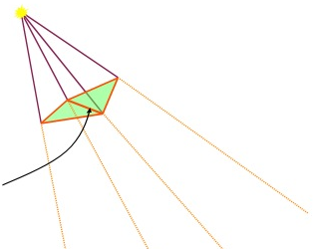
Shadow Volumes from Silhouette Edges
Merging shadow volumes:
An interior edge (non-silhouette edge as seen from the light position) creates two shadow quads that cancel each other out:
This interior edge makes
two quads, which cancel out
Notes:
Shadow volumes can be merged. An edge that is shared by two triangles facing the light creates two shadow quads that cancel each other out.
Thus, it is popular to create shadow volumes only from the silhouette edges (click) as seen from the light source. An edge is considered a silhouette edge if it has a back-facing and a front-facing triangle connected to it.
This avoids rendering of many useless shadow quads

Slide 33
Shadow Volumes from Silhouette Edges
Merging shadow volumes:
An interior edge (non-silhouette edge as seen from the light position) creates two shadow quads that cancel each other out:
Thus, popular to create shadow volumes only from the silhouette edges.
Avoids rendering of many useless shadow quads
This interior edge makes
two quads, which cancel out
Notes:
Shadow volumes can be merged. An edge that is shared by two triangles facing the light creates two shadow quads that cancel each other out.
Thus, it is popular to create shadow volumes only from the silhouette edges as seen from the light source. An edge is considered a silhouette edge if it has a back-facing and a front-facing triangle connected to it.
This avoids rendering of many useless shadow quads

Slide 34
Shadow Volumes from Silhouette Edges
Merging shadow volumes:
An interior edge (non-silhouette edge as seen from the light position) creates two shadow quads that cancel each other out:
Thus, popular to create shadow volumes only from the silhouette edges.
Avoids rendering of many useless shadow quads
A real example:
This works like a charm for closed objects.
What about non-closed objects?
Notes:
Here we can see all triangle edges. And instead of creating shadow quads for each edge, we only create quads for the silhouette edges as seen from the light source.

Slide 35
Shadow Volumes from Silhouette Edges
It is a misconception that objects needs to be closed to remove non-silhouette edges.
closed object
Stencil value >0 means shadow
+1
0
Notes:
The fact that shadow volume quads are created only from the silhouette edges has lead to the very common misconception that shadow casters need to be closed in order for shadow volumes to work.
Here is a closed object and the corresponding counting for two pixels.

Slide 36
Shadow Volumes from Silhouette Edges
It is a misconception that objects needs to be closed to remove non-silhouette edges.
Problem:
non-closed object
Stencil value >0 means shadow
0
-1
Notes:
Here is a non-closed object, and (click) this pixel gets a count of 0, since it is behind a front and backfacing quad, which incorrectly means that it is non-shadowed.
and this far pixel even receives a negative value.
What happened?

Slide 37
Shadow Volumes from Silhouette Edges
It is a misconception that objects needs to be closed to remove non-silhouette edges.
Fixed by:
-1
-1
+2
+1
0
Notes:
Well… In this case, the silhouette edges with two adjacent triangles should create shadow quads that inc/dec count by 2, since such an edge would give rise to two shadow quads if we would have created the quads separately for each triangle.
this edge has 2 adjacent triangles, so it should increment by 2.
this egde has 1 adjacent triangle, so it decrements by 1.
and this edge also decrements by 1.
And now you can see that the counting goes right .
The drawback is that 8 bits stencil buffers easily overflows with this modification. We need 16-bit stencil buffers.
[Bergeron 86], [Aldridge and Woods 04], [Kim et al. 08]

Slide 38
Shadow Volumes from Silhouette Edges
It is a misconception that objects needs to be closed to remove non-silhouette edges.
Fixed by:
uffe@chalmers.se
Preprocess (or in geometry shader):
For each triangle edge e in scene:
Choose edge e’s direction
Create e’s shadow volume quad
For each adjacent triangle
Inc/dec edge counter c_{e} depending on if triangle’s created shadow volume quad would have same/opposite facing of e’s quad.
Add quad to list L, if c_{e} != 0.
At rendering:
Render all quads in L, and inc/dec stencil by quad’s c_{e} depending on if quad is front/back-facing eye.
For 100% robustness, see our book Real-Time Shadows
-1
-1
+2
+1
0
Works identically for Z-fail
Notes:
In the general case of triangle connectivity this is the algorithm to follow. It is in our book Real-Time Shadows.
It is possible to skip any winding-order concept if you follow this algorithm. In the real world, triangles don’t have any winding order, and the shadow is the same, no matter in what order the vertices come.
For each triangle edge in the scene like this one,
we choose the edge’s direction, arbitrarily .
Then, we create a shadow-volume quad corresponding to the edge, with the facing corresponding to the edge’s chosen direction and the right hand rule.
Now, for each adjacent triangle,
we increment or decrement a counter, depending on whether that triangle’s quad would have the same or opposite facing of our edge’s quad.
We keep all quads with a non-zero counter, and at rendering, we draw these quads and increment or decrement with the quad’s counter depending on if the quad is front- or back-facing the eye.

Slide 39
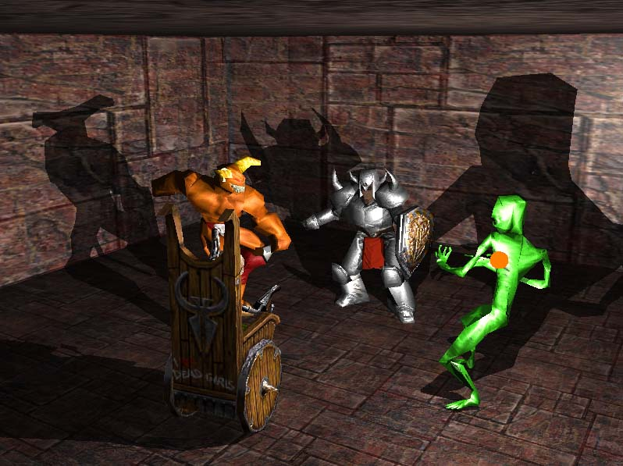
Shadow Volumes - Summary
Pros:
High quality
Cons:
OVERDRAW
Notes:
So, here is a summary of shadow volumes.
The good thing is that we get razor sharp edges. Often too sharp, actually.
And we don’t have any biasing problems or jagged shadow edges.
The drawback is that every silhouette edge causes shadow quads which typically are very elongated, with a bad rasterizing performance.
Therefore, culling and clamping of shadow volumes has been suggested.

Slide 40
Culling and Clamping
Culling of Shadow Volumes [Lloyd et al. 2004][Stich et al. 2007]
Culling of Shadow Casters if it is located totally within shadow
Tested against a shadow depth map
Notes:
Lets take a look at Culling and Clamping that was introduced by Lloyd et al.
Caster Culling is when you avoid generating shadow volumes for (click) shadow casters that already are fully located within shadows.
This is tested conservatively using a shadow map.
Culling Lloyd et al.’s CC Shadow Volumes [Lloyd et al., 2004] reduce rendering by using
culling of shadow casters that are located completely in shadow and elimination of shadow casters
whose shadows are not visible to the eye. Furthermore, shadows that does not influence
visible shadow receivers are culled. This is all tested by creating a shadow depth map, from the
light’s view. In addition, the shadow receivers are rendered (still from the light’s view) to the
stencil buffer setting the stencil value where the depth test fails, which identifies the shadowed
regions. Then, occlusion queries are used when rendering the bounding boxes of the shadow
casters, from the viewpoint of the light, with the depth test plus the stencil test enabled (where
the stencil test fails for set values). If no pixel is rendered, the shadow caster is either in shadow
or does not influence any visible shadow receiver, in which case the caster’s shadow volumes can
safely be ignored.
A more recent approach to reduce the actual number of necessary shadow volumes is described
in [Stich et al., 2007]. Here a scene hierarchy is exploited and only visible shadow volumes
intervene in the shadow computations; this is conservatively estimated based on occlusion culling
using bounding-volume hierarchies.

Slide 41
Culling and Clamping
Clamping of Shadow Volumes [Lloyd et al. 2004] [Eisemann and Decoret 2006]
Idea: Only render parts of shadow quads that affects a shadow receiver
Tested against AABB around shadow receivers
Notes:
Clamping is when you only rasterize the shadow quads for regions that contain shadow receivers. You skip the other areas – by using clip-planes and rasterizing separately for frustum slices.
-----------------
Clamping In addition to using culling (see above) Lloyd et al.’s CC Shadow Volumes [Lloyd
et al., 2004] also uses clamping of the shadow volumes to avoid unnecessary rasterization. They
use two dierent and orthogonal methods, in the sense that they preferably should be used
in combination. The first is called Continuous Shadow Clamping, where shadow volumes are
clamped by using AABBs around the shadow receivers to achieve clamped shadow volumes
only around the regions of interest. The second is called Discrete Shadow Clamping and clamps
the shadow volumes to intervals defined by slicing planes that divides the view frustum into layers
with slicing planes facing the light source and passing through the viewpoint. The rational
is that for a given layer, the potential receivers are rendered with the two delimiting planes as
clipping planes. In addition, the projection (from the light source) of each caster on the furthest
of the two delimiting planes is rendered with a depth test. If no fragment passes the depth test
(tested with an occlusion query), the shadow volume can be clamped for layers that lies further
from the light source.

Slide 42
Culling and Clamping
Culling of Shadow Volumes [Lloyd et al. 2004] [Eisemann and Decoret 2006]
Receiver Culling
Idea: Cull part of shadow volumes where shadow receivers are not visible from the eye
Notes:
The final trick is receiver culling. We avoid rasterizing parts of shadow volumes that only covers shadow receivers that are not visible from the eye anyway (tested by occlusion queries).
R is occluded by B
Culling Lloyd et al.’s CC Shadow Volumes [Lloyd et al., 2004] reduce rendering by using
culling of shadow casters that are located completely in shadow and elimination of shadow casters
whose shadows are not visible to the eye. Furthermore, shadows that does not influence
visible shadow receivers are culled. This is all tested by creating a shadow depth map, from the
light’s view. In addition, the shadow receivers are rendered (still from the light’s view) to the
stencil buer setting the stencil value where the depth test fails, which identifies the shadowed
regions. Then, occlusion queries are used when rendering the bounding boxes of the shadow
casters, from the viewpoint of the light, with the depth test plus the stencil test enabled (where
the stencil test fails for set values). If no pixel is rendered, the shadow caster is either in shadow
or does not influence any visible shadow receiver, in which case the caster’s shadow volumes can
safely be ignored.
A more recent approach to reduce the actual number of necessary shadow volumes is described
in [Stich et al., 2007]. Here a scene hierarchy is exploited and only visible shadow volumes
intervene in the shadow computations; this is conservatively estimated based on occlusion culling
using bounding-volume hierarchies.

Slide 43
Culling and Clamping
Illustrates reduced depth complexity when using Culling and Clamping
Notes:
Here you see a side by side comparison, showing the reduction in overdraw when using culling and clamping.

Slide 44
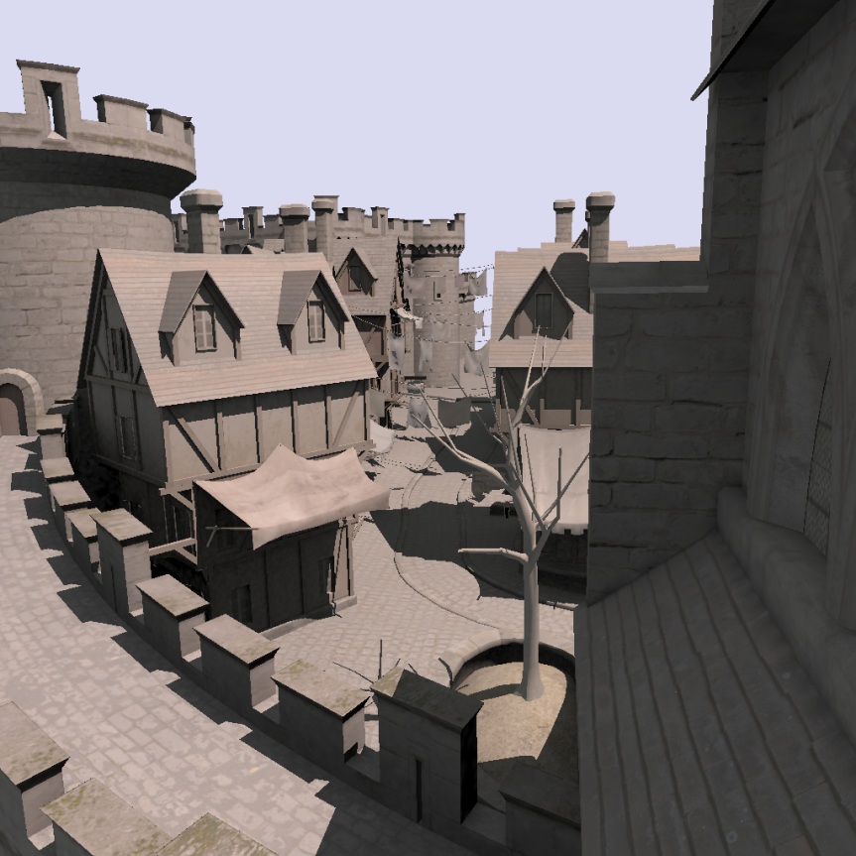
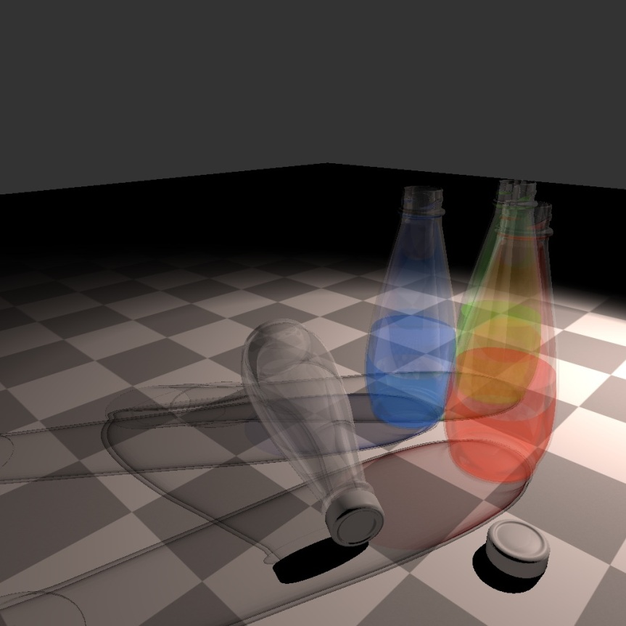
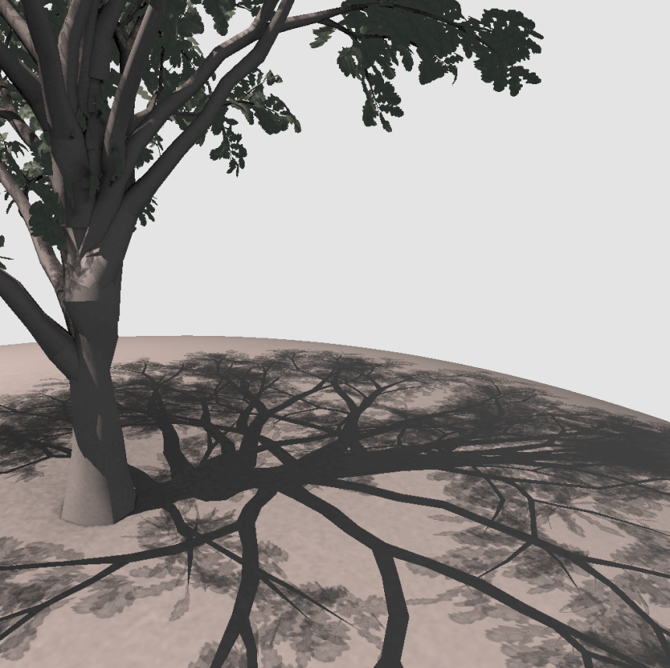
Per-Triangle Shadow Volumes
Per-triangle Shadow Volumes [Sintorn et al., 2011]
Idea:
Return to using one shadow volume per triangle
100% robust + easiest.
Achieve efficiency by changing rasterization primitive from shadow quad to triangle shadow volume against hierarchical shadow buffer
Using CUDA rasterization
Allows for a much more general and robust algorithm
Notes:
Let’s look at one final and fairly new method, which rasterizes a shadow volume per triangle, and avoids culling and clamping while still being efficient. It is robust, and trivially handles semi-transparent textured shadow caster (like you see for the shadows from this tree or the transparent bottles).
The trick is to rasterize the full triangle shadow volumes as one primitive (instead of rasterizing the individual shadow volume quads) and doing this against a hierarchical shadow buffer. The drawback is that it requires CUDA-rasterization.
Pixel accurate (no bias, no robustness issues, trivially handles semi-transparent textured shadow casters)
We return to used one shadow volume per triangle. The trick is that we rasterize these against a hierarchical frame buffer. This is done with CUDA. The idea is quite simple. The nice thing is that it is surprisingly efficient…->
I will now give a brief overview of the algorithm and then I will discuss some details and our implementation. What we propose is a variation of the original shadow volume algorithm, where we return to the idea of using a single shadow volume per triangle.
That might sound excessive, but we manage to do so efficiently however, by changing the rasterization primitive from shadow quad to shadow volume in a custom rasterizer.
In fact, we will show that casting a shadow volume per triangle allows for a much more efficient, robust and general algorithm.

Slide 45
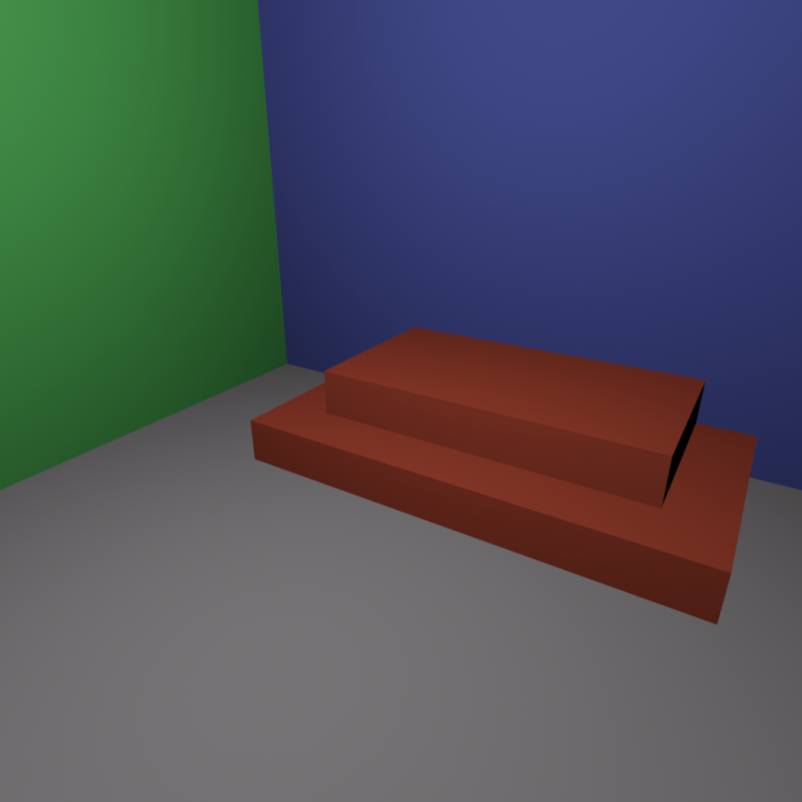
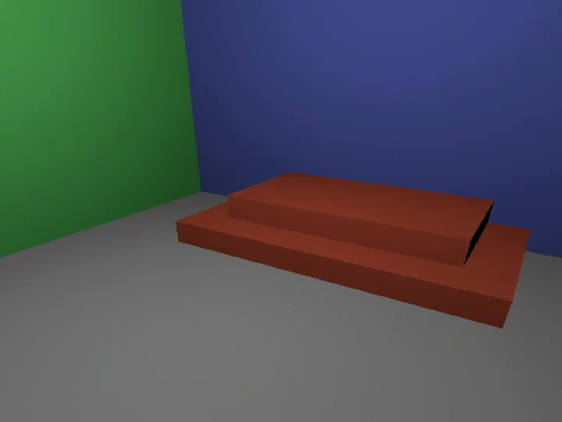
Algorithm Overview
View from camera
Alternative view
Notes:
Now lets see how it works. To your left is a scene as viewed from the camera, and to the right is an alternative view where you see the camera frustum.

Slide 46
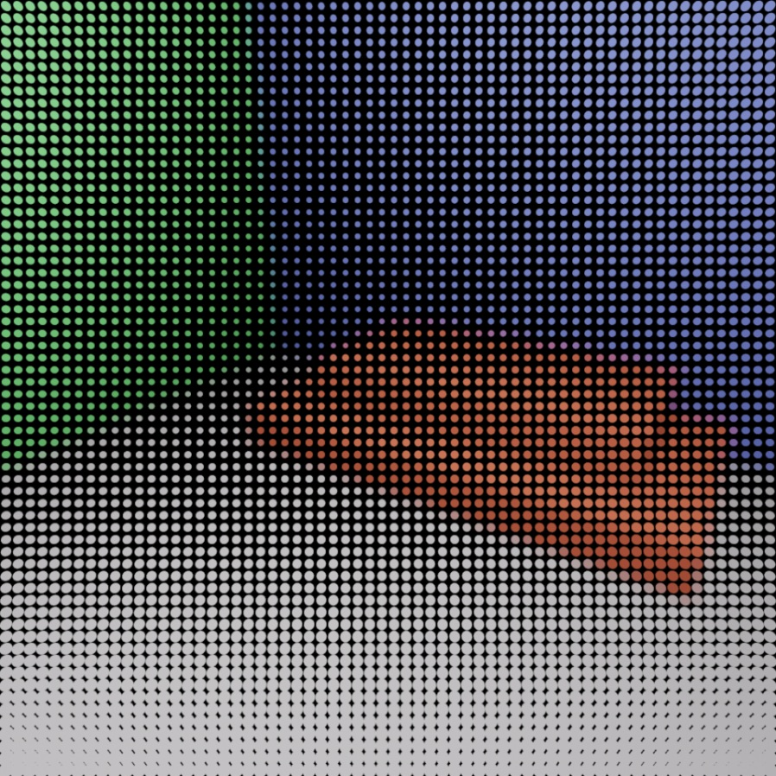
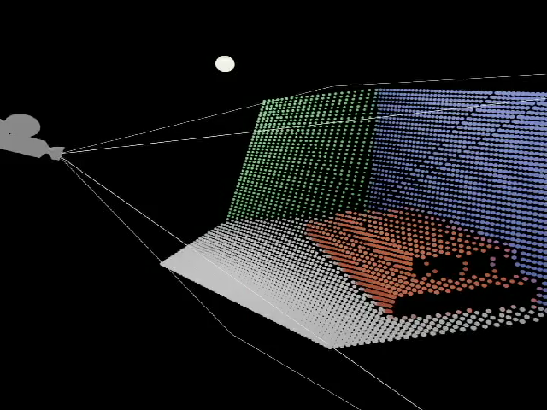
Algorithm Overview Building the depth hierarchy
View from camera
Alternative view
Notes:
First, we render the scene to produce a zbuffer. The zbuffer gives us the positions of all view samples that are to be considered for shadowing.

Slide 47
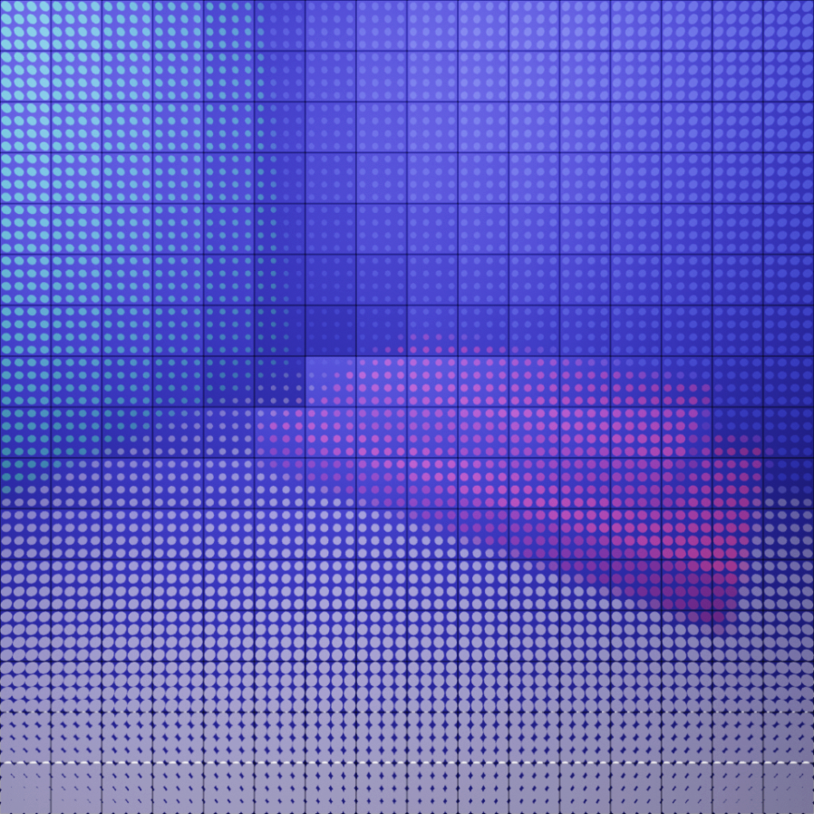
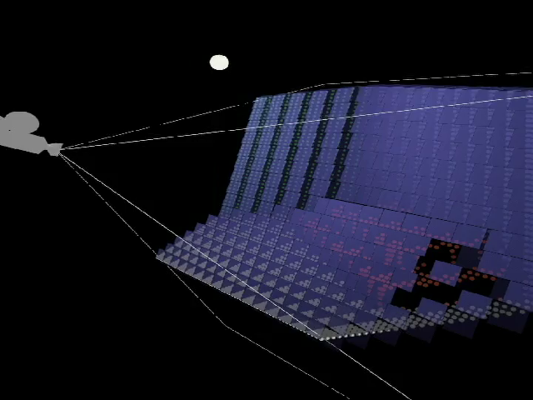
Algorithm Overview Building the depth hierarchy
View from camera
Alternative view
Notes:
Then, we build a depth hierarchy by grouping tiles of lets say 4x4 viewsamples and calculating their bounding frustums. This is just a matter of finding the minimum and maximum z-value in each tile.

Slide 48

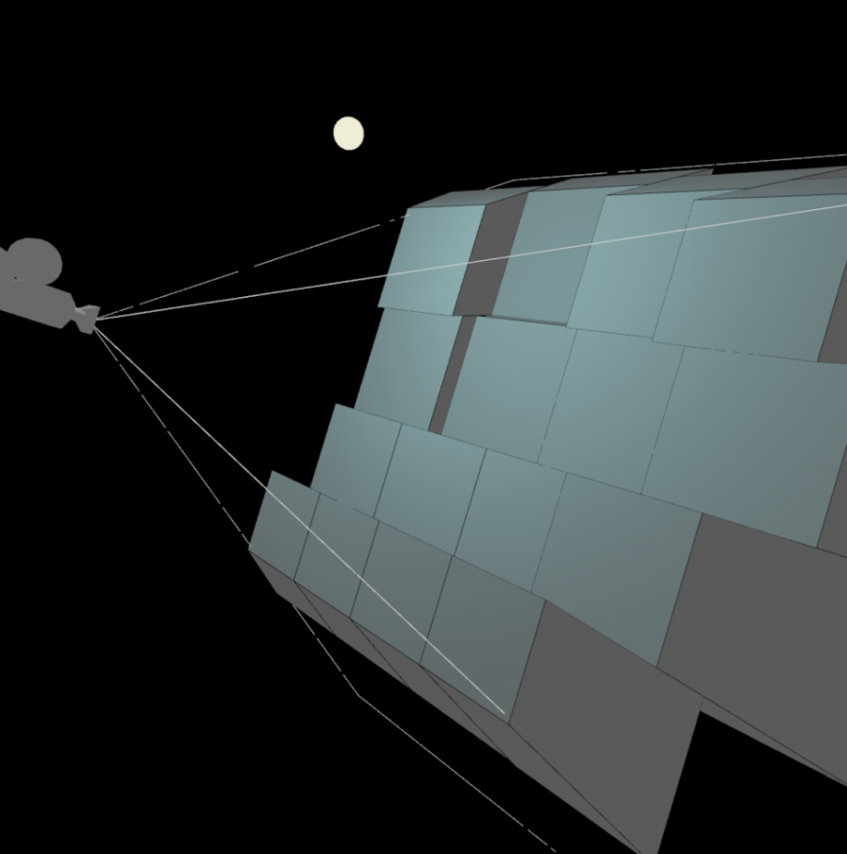
Algorithm Overview Building the depth hierarchy
View from camera
Alternative view
Notes:
We proceed, bottom up, building the hierarchy until we have, in this case, a top level of 4x4 3D-tiles.

Slide 49
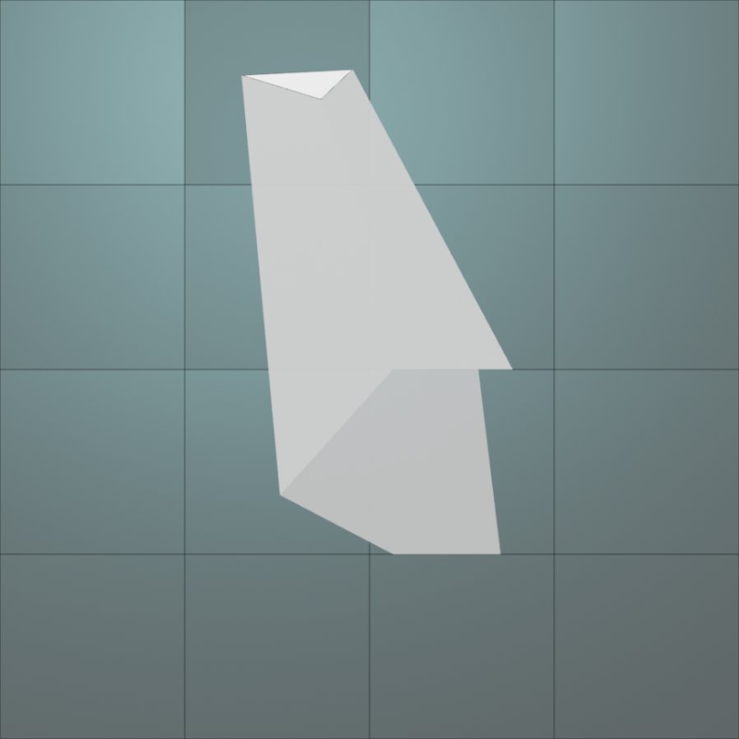
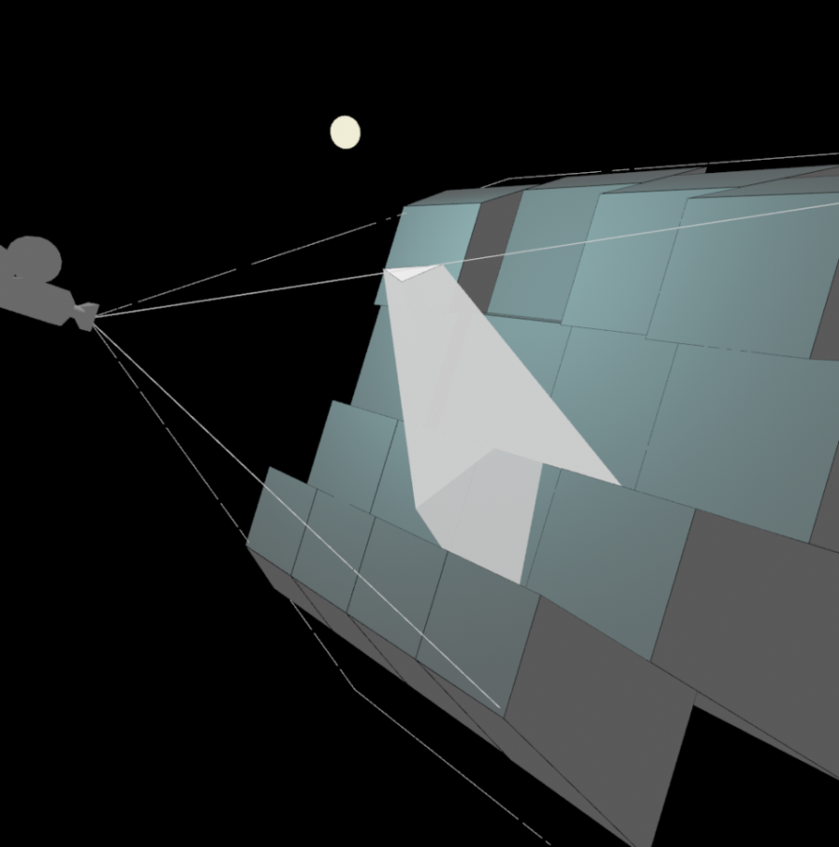
Algorithm Overview Traversing the hierarchy
View from camera
Alternative view
Notes:
Now lets see how this hierarchy is traversed to find the pixels that are in shadow.
For every shadow casting triangle (like this), we test the triangle’s shadow volume frustum for intersection against each 3D-tile, and we do this recursively down to the bottom. And the bottom contains each individual view sample.
So, we recursively go down the intersected tiles.
We discard all tiles that are completely outside the volume, as the contained samples will not be in shadow, and...
we can also quickly cull any tile that is found to be entirely inside a volume.
Like this one.
For large shadows, this optimization can cull a great deal of viewsamples. All samples that belong to this red tile are guaranteed to be in shadow, and so they can just be marked as such and we do not need to traverse them further.
This speeds up a lot for large triangles – and small are fast anyway.
And thats it. It works very much like hierarchical rasterization of triangles, except we rasterize per-triangle shadow volumes.
These are the final pixels that are found to be in shadow.

Slide 50
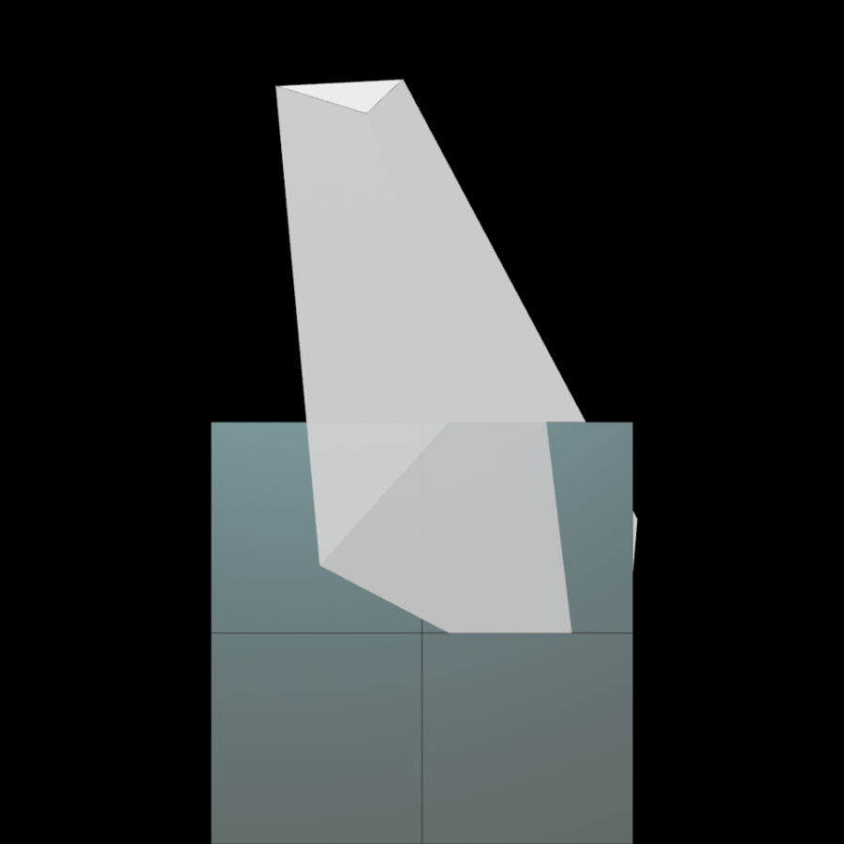
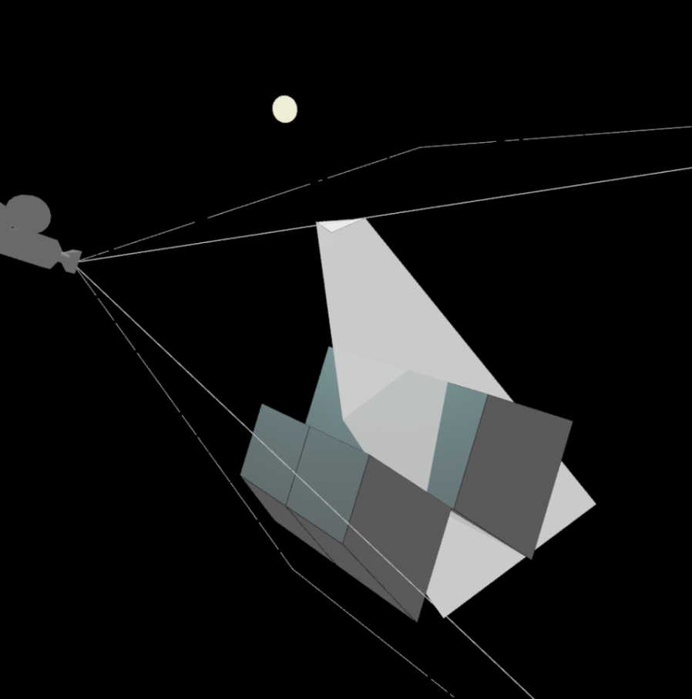
Algorithm Overview Traversing the hierarchy – Cull 4x4 tiles
View from camera
Alternative view
Notes:
Now lets see how this hierarchy is traversed to find the pixels that are in shadow.
For every shadow casting triangle (like this), we test the triangle’s shadow volume frustum for intersection against each 3D-tile, and we do this recursively down to the bottom. And the bottom contains each individual view sample.
So, we recursively go down the intersected tiles.
We discard all tiles that are completely outside the volume, as the contained samples will not be in shadow, and...
we can also quickly cull any tile that is found to be entirely inside a volume.
Like this one.
For large shadows, this optimization can cull a great deal of viewsamples. All samples that belong to this red tile are guaranteed to be in shadow, and so they can just be marked as such and we do not need to traverse them further.
This speeds up a lot for large triangles – and small are fast anyway.
And thats it. It works very much like hierarchical rasterization of triangles, except we rasterize per-triangle shadow volumes.
These are the final pixels that are found to be in shadow.

Slide 51
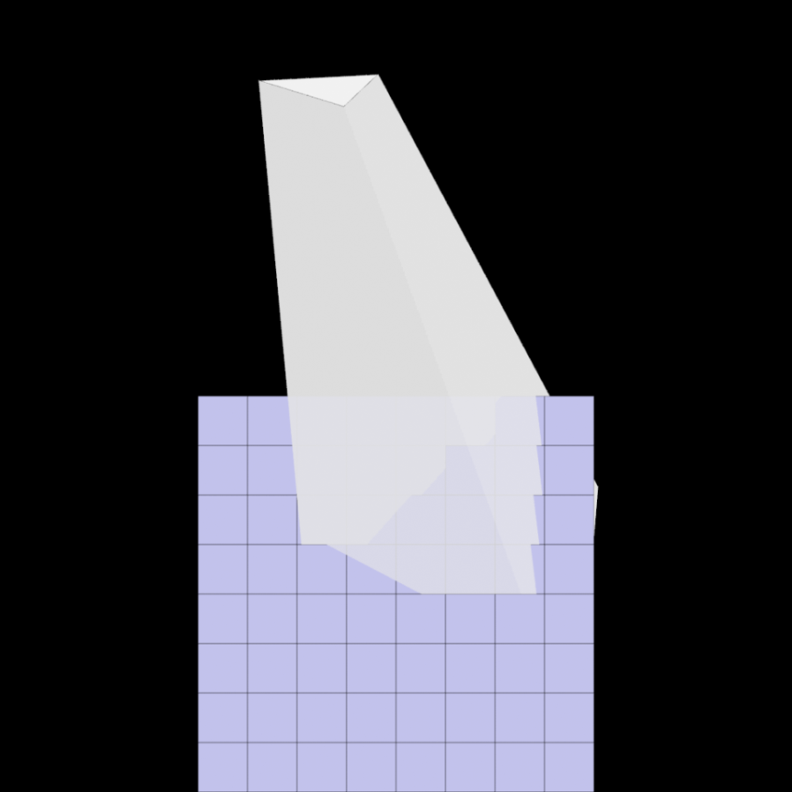
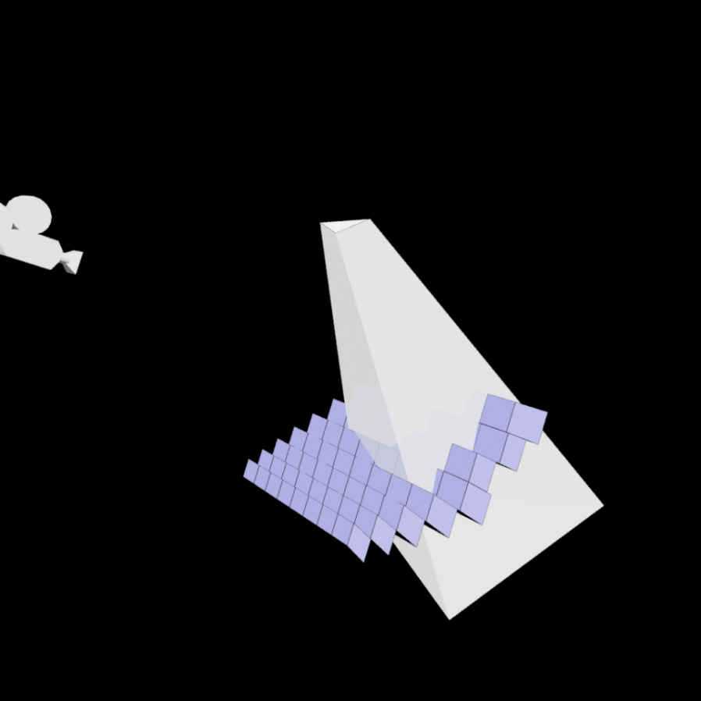
Algorithm Overview Traversing the hierarchy – Cull 4x4 tiles
View from camera
Alternative view
Notes:
Now lets see how this hierarchy is traversed to find the pixels that are in shadow.
For every shadow casting triangle (like this), we test the triangle’s shadow volume frustum for intersection against each 3D-tile, and we do this recursively down to the bottom. And the bottom contains each individual view sample.
So, we recursively go down the intersected tiles.
We discard all tiles that are completely outside the volume, as the contained samples will not be in shadow, and...
we can also quickly cull any tile that is found to be entirely inside a volume.
Like this one.
For large shadows, this optimization can cull a great deal of viewsamples. All samples that belong to this red tile are guaranteed to be in shadow, and so they can just be marked as such and we do not need to traverse them further.
This speeds up a lot for large triangles – and small are fast anyway.
And thats it. It works very much like hierarchical rasterization of triangles, except we rasterize per-triangle shadow volumes.
These are the final pixels that are found to be in shadow.

Slide 52
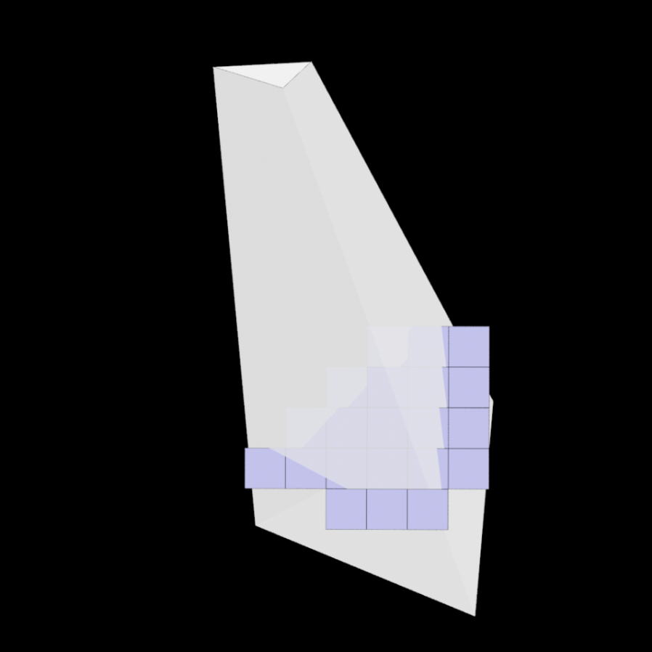
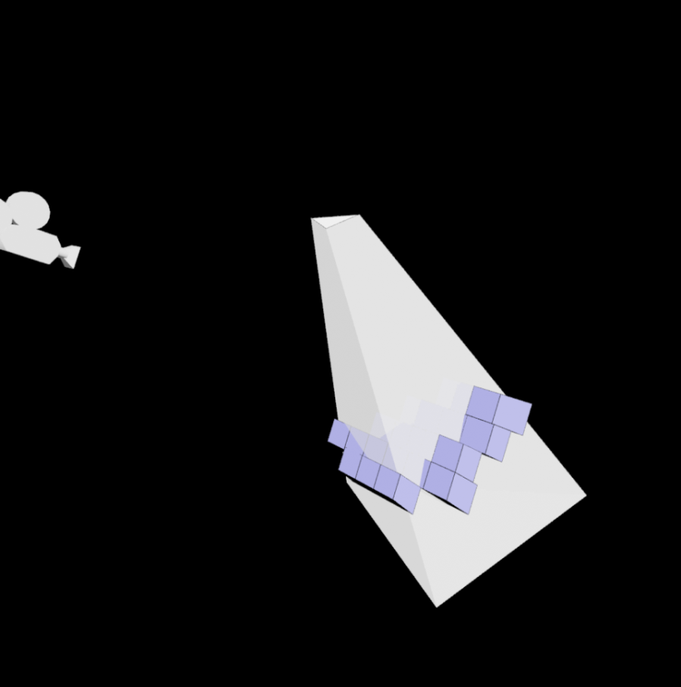
Algorithm Overview Traversing the hierarchy – Cull 4x4 tiles
View from camera
Alternative view
Notes:
Now lets see how this hierarchy is traversed to find the pixels that are in shadow.
For every shadow casting triangle (like this), we test the triangle’s shadow volume frustum for intersection against each 3D-tile, and we do this recursively down to the bottom. And the bottom contains each individual view sample.
So, we recursively go down the intersected tiles.
We discard all tiles that are completely outside the volume, as the contained samples will not be in shadow, and...
we can also quickly cull any tile that is found to be entirely inside a volume.
Like this one.
For large shadows, this optimization can cull a great deal of viewsamples. All samples that belong to this red tile are guaranteed to be in shadow, and so they can just be marked as such and we do not need to traverse them further.
This speeds up a lot for large triangles – and small are fast anyway.
And thats it. It works very much like hierarchical rasterization of triangles, except we rasterize per-triangle shadow volumes.
These are the final pixels that are found to be in shadow.

Slide 53
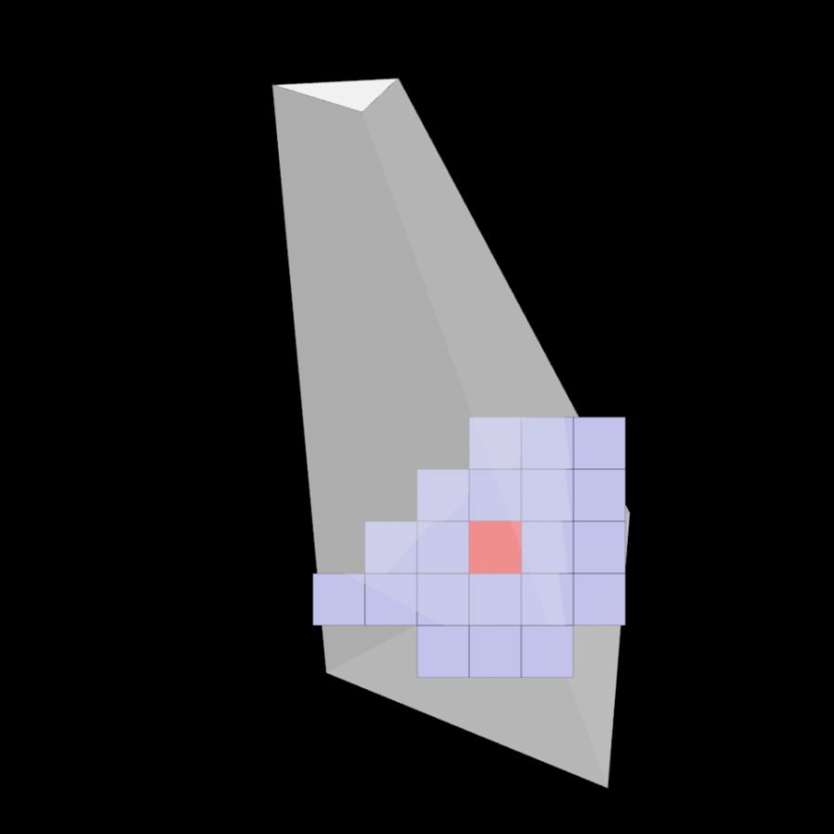
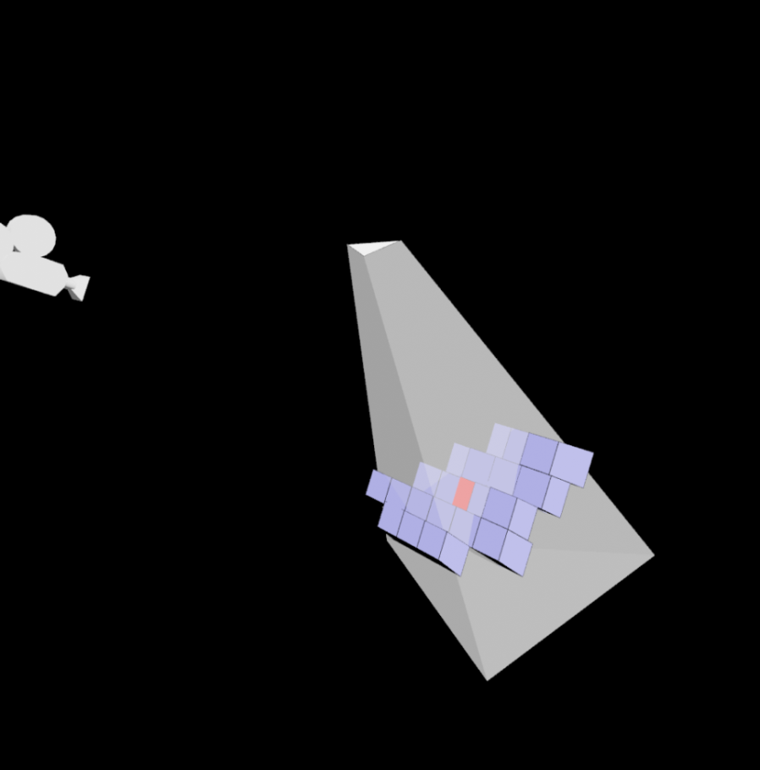
Algorithm Overview Traversing the hierarchy – Trivial Accept
View from camera
Alternative view
Notes:
Now lets see how this hierarchy is traversed to find the pixels that are in shadow.
For every shadow casting triangle (like this), we test the triangle’s shadow volume frustum for intersection against each 3D-tile, and we do this recursively down to the bottom. And the bottom contains each individual view sample.
So, we recursively go down the intersected tiles.
We discard all tiles that are completely outside the volume, as the contained samples will not be in shadow, and...
we can also quickly cull any tile that is found to be entirely inside a volume.
Like this one.
For large shadows, this optimization can cull a great deal of viewsamples. All samples that belong to this red tile are guaranteed to be in shadow, and so they can just be marked as such and we do not need to traverse them further.
This speeds up a lot for large triangles – and small are fast anyway.
And thats it. It works very much like hierarchical rasterization of triangles, except we rasterize per-triangle shadow volumes.
These are the final pixels that are found to be in shadow.

Slide 54
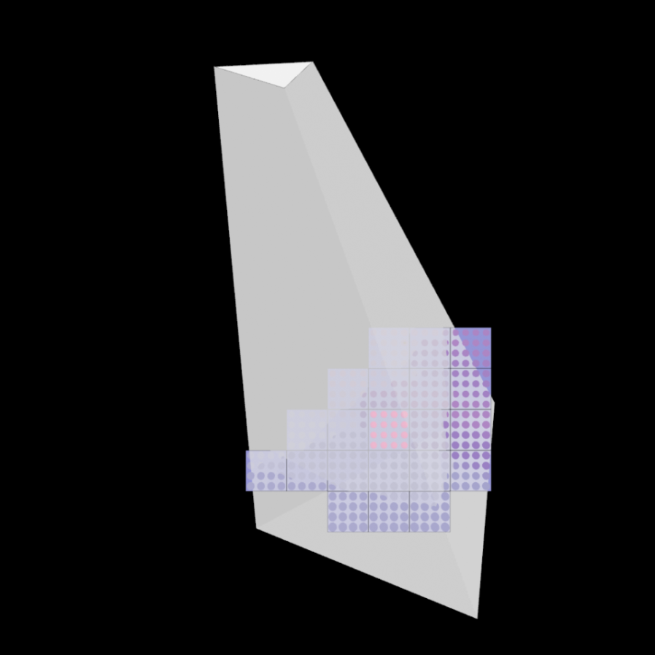
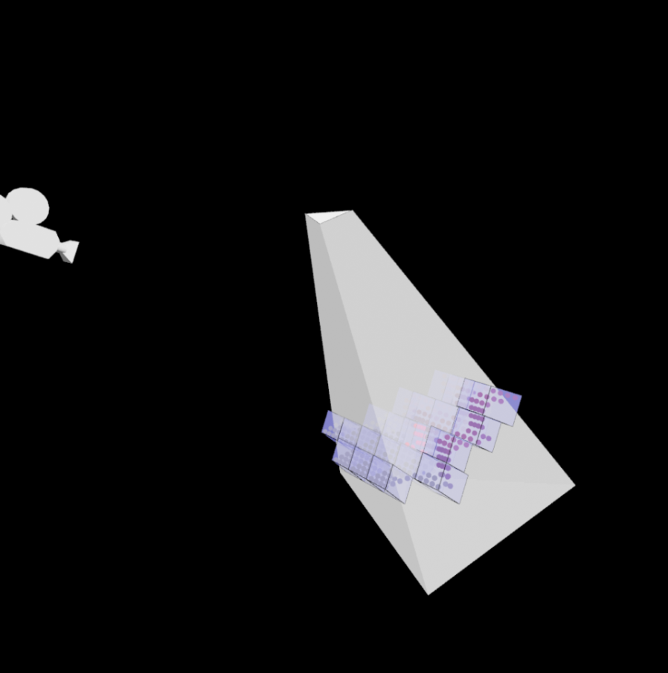
Algorithm Overview Traversing the hierarchy – Trivial Accept
View from camera
Alternative view
Notes:
Now lets see how this hierarchy is traversed to find the pixels that are in shadow.
For every shadow casting triangle (like this), we test the triangle’s shadow volume frustum for intersection against each 3D-tile, and we do this recursively down to the bottom. And the bottom contains each individual view sample.
So, we recursively go down the intersected tiles.
We discard all tiles that are completely outside the volume, as the contained samples will not be in shadow, and...
we can also quickly cull any tile that is found to be entirely inside a volume.
Like this one.
For large shadows, this optimization can cull a great deal of viewsamples. All samples that belong to this red tile are guaranteed to be in shadow, and so they can just be marked as such and we do not need to traverse them further.
This speeds up a lot for large triangles – and small are fast anyway.
And thats it. It works very much like hierarchical rasterization of triangles, except we rasterize per-triangle shadow volumes.
These are the final pixels that are found to be in shadow.

Slide 55
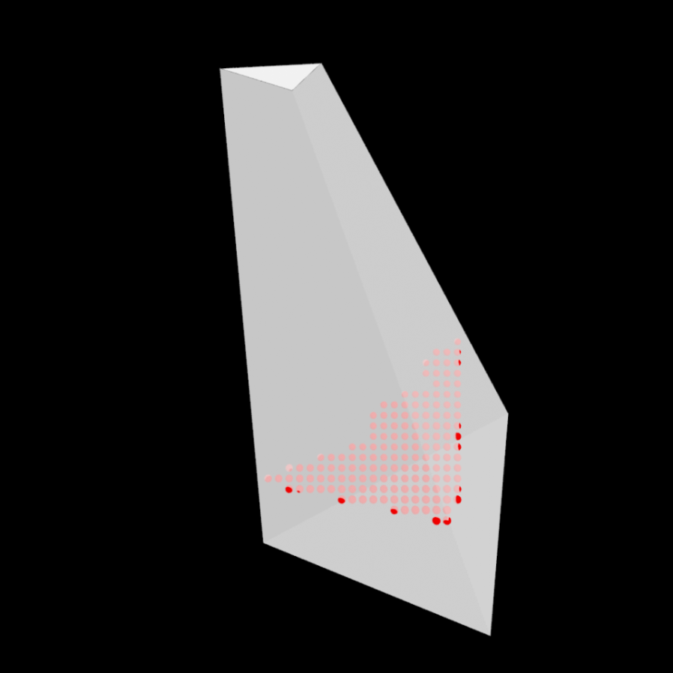
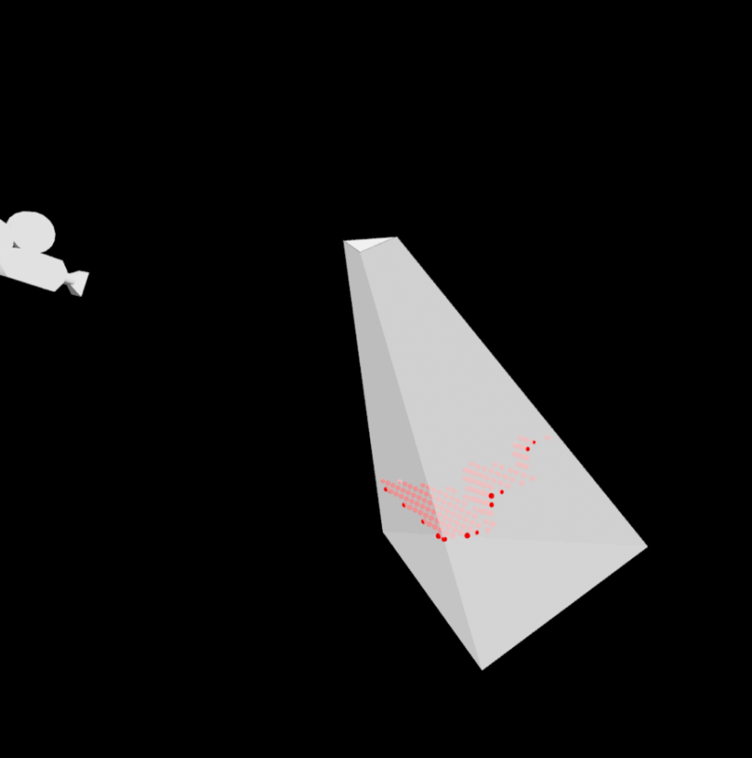
Algorithm Overview Traversing the hierarchy – Test samples
View from camera
Alternative view
Notes:
Now lets see how this hierarchy is traversed to find the pixels that are in shadow.
For every shadow casting triangle (like this), we test the triangle’s shadow volume frustum for intersection against each 3D-tile, and we do this recursively down to the bottom. And the bottom contains each individual view sample.
So, we recursively go down the intersected tiles.
We discard all tiles that are completely outside the volume, as the contained samples will not be in shadow, and...
we can also quickly cull any tile that is found to be entirely inside a volume.
Like this one.
For large shadows, this optimization can cull a great deal of viewsamples. All samples that belong to this red tile are guaranteed to be in shadow, and so they can just be marked as such and we do not need to traverse them further.
This speeds up a lot for large triangles – and small are fast anyway.
And thats it. It works very much like hierarchical rasterization of triangles, except we rasterize per-triangle shadow volumes.
These are the final pixels that are found to be in shadow.

Slide 56
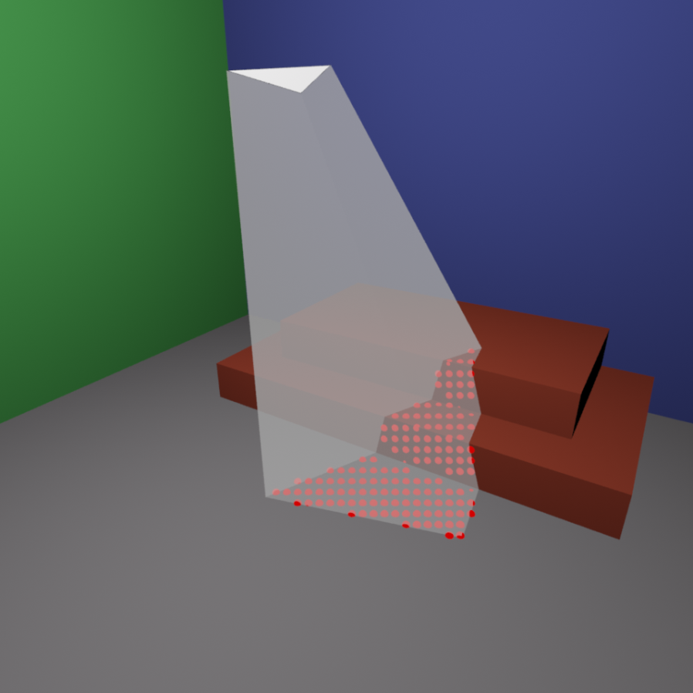
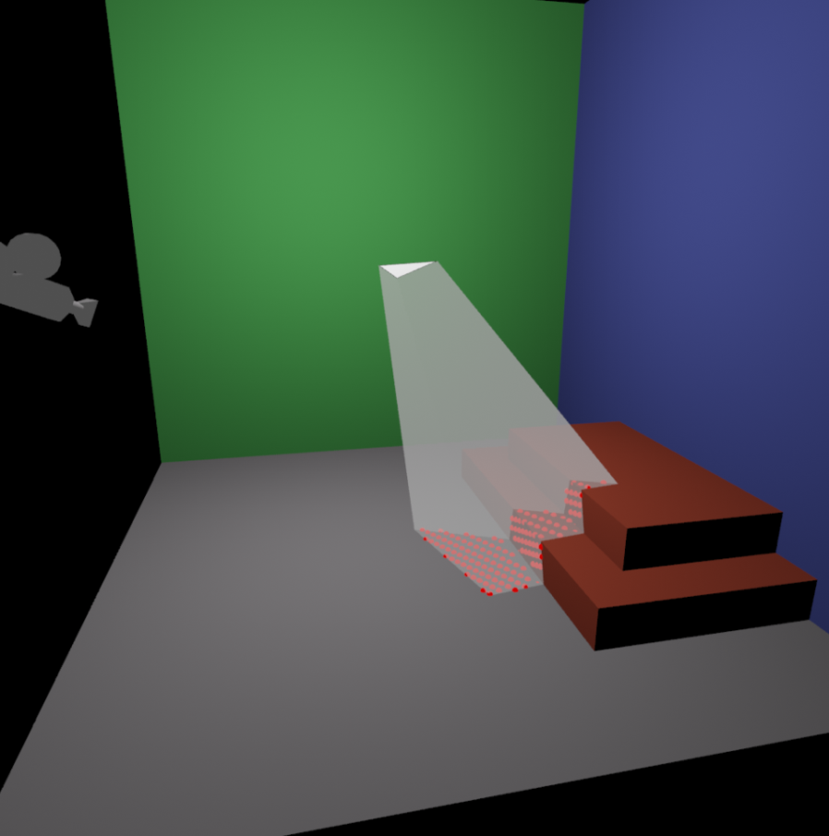
Algorithm Overview
View from camera
Alternative view
Notes:
Now lets see how this hierarchy is traversed to find the pixels that are in shadow.
For every shadow casting triangle (like this), we test the triangle’s shadow volume frustum for intersection against each 3D-tile, and we do this recursively down to the bottom. And the bottom contains each individual view sample.
So, we recursively go down the intersected tiles.
We discard all tiles that are completely outside the volume, as the contained samples will not be in shadow, and...
we can also quickly cull any tile that is found to be entirely inside a volume.
Like this one.
For large shadows, this optimization can cull a great deal of viewsamples. All samples that belong to this red tile are guaranteed to be in shadow, and so they can just be marked as such and we do not need to traverse them further.
This speeds up a lot for large triangles – and small are fast anyway.
And thats it. It works very much like hierarchical rasterization of triangles, except we rasterize per-triangle shadow volumes.
These are the final pixels that are found to be in shadow.
Let’s look at a sumary of shadow maps vs shadow volumes…

Slide 57
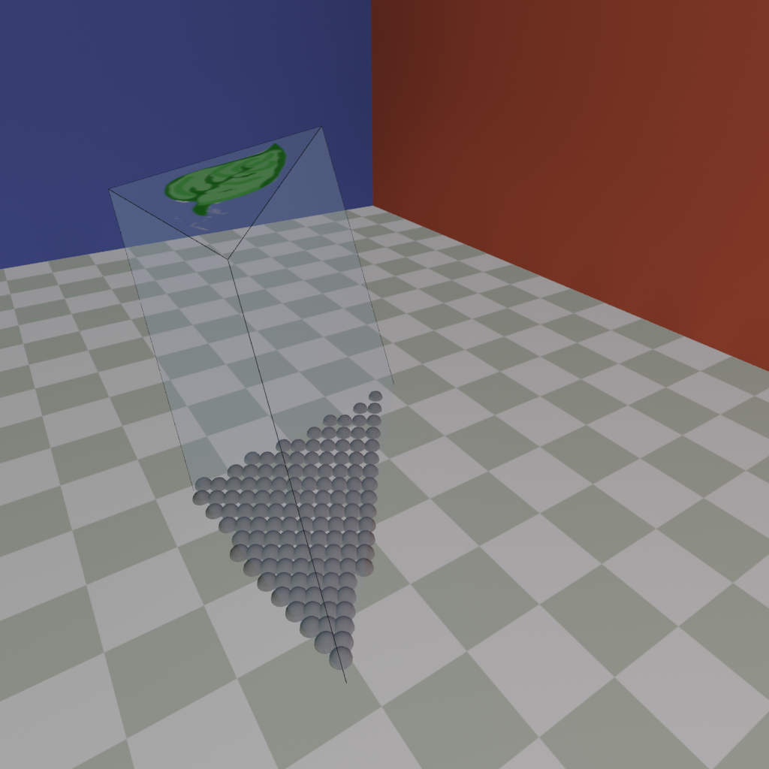
Semi-Transparent Textured Shadows
Distances from SV planes yield barycentric coordinates
Lets us interpolate texture coords
Can fetch opacity before deciding if the view sample is shadowed
Notes:
One benefit of considering every single triangle-shadow volume is that shadows cast from textured and alpha masked triangles become trivial. This was also shown by Jon Hasselgren and Tomas Akenine-Möller in a paper called textured shadow volumes.
When a view sample is processed to see if it lies inside the shadow volume, it is simple to find its barycentric coordinates from its distances to the shadow volume planes.
With these, we can interpolate the texture coordinates and simply discard the sample if the texture is transparent at that point, or multiply the shadow value with the alpha value to get textured semi-transparency. This requires a floating point buffer for the shadow buffer.

Slide 58
Semi-Transparent Textured Shadows
Distances from SV planes yield barycentric coordinates
Lets us interpolate texture coords
Can fetch opacity before deciding if the view sample is shadowed
Notes:
One benefit to considering every single triangle shadow volume is that shadows cast from textured alpha masked triangles are trivial. This was also shown by Jon Hasselgren and Akenine Möller in a paper called textured shadow volumes.
When a viewsample is processed to see if it lies inside the shadow volume, it is simple to find its barycentric coordinates from its distances to the shadow volume planes.
With these, we can interpolate the texture coordinates and simply discard the sample if the texture is transparent at that point, or multiply the shadow value with the alpha value to get textured semi-transparency. This requires a floating point buffer for storing the shadows.

Slide 59
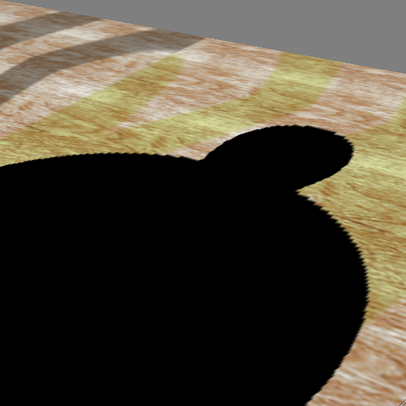
Shadow Maps vs Shadow Volumes
Shadow Maps
Shadow Volumes
Good: Handles any rasterizable geometry, lookup: constant cost regardless of complexity, map can sometimes be reused. Very fast.
Bad: Frustum limited. Jagged shadows if res too low, biasing headaches.
Solution: next talk…
Good: shadows are sharp. Handles omni-directional lights.
Bad: 3 passes. Shadow polygons must be generated and rendered → lots of polygons & fill
Solution: Culling & Clamping or Per-triangle SV using CUDA.
Notes:
Here is a summary of shadow maps vs shadow volumes.
Essentially shadow volumes have pixel perfect quality, but are typically significantly slower than shadow maps. They are also harder to filter to get softer edges. And most importantly… shadow volumes can be made 100% robust. Remember that not even ray tracing is robust, where we use the epsilon for the shadow rays.
Shadow maps, on the other hand, are extremely fast, but the problem is the quality.
And increasing the shadow map quality is the topic of the next talk, by Michael Wimmer.
And Fillrate limited, generate lots of fragments.
Shadow Volumes take about 2ms (at best) for the Epic Citadell-scene.
If a few milliseconds is OK in your application (e.g., industrial simulation) and you need pixel accuracy, then go for shadow volumes. Today, they are simple to implement and pixel accurate.
For most games, however, a few milliseconds per light is too much.
Shadow maps take ~0.1ms.
(It should be noted that for omni-directional lights, four shadow maps are needed, though.)
Therefore, it is very appealing to be able to use shadow maps and limit the bias and resolution issues. This is the topic of the next session, coming right now…
Hand over to Michael Wimmer

Slide 60
The End - of Basic Shadow Techniques: Shadow Maps and Shadow Volumes
Ulf Assarsson

